Slide 1



IAPA USA Regional Conference
Portland, Oregon
June 24-26, 2016
Dave Springsteen, CPA, CGMA
Partner, Practice Leader
National Tax Services
WithumSmith+Brown, PC
5 Vaughn Drive
Princeton, NJ 08540
T (609) 520 1188
M (732) 598 8924
F (609) 514 5906
dspringsteen@withum.com

Slide 2



soccer
https://www.youtube.com/watch?v=8F9jXYOH2c0

Slide 3
Top tax newsmakers
1. Panama
2. FATCA
3. Inversions
4. Social Tax- Apple, Google, McDonald’s and Starbucks
5. Tangible Personal Regulations
6. BEP’s
7. Internet Taxation (E-Commerce)
8. Tough Times @ IRS- Audit Stats
9. Tax Related ID Theft
10. Cloud Computing
11. Carbon Taxes

Slide 4
panama
A hack of a Panama-based law firm resulted in 11.5 million documents from the law firm's database (the “Panama Papers”) being leaked.
The Panama Papers implicate high-profile business leaders, athletes and other influential individuals in using shell companies and overseas tax havens to shield cash from taxation.
In remarks delivered on April 5, President Obama said, “Tax avoidance is a big global problem. A lot of it's legal, but that's exactly the problem. It's not that they're breaking the laws, it's that the laws are so poorly designed.”

Slide 5
fatca
Designed to identify assets of U.S. persons being held offshore
New withholding regime imposes a withholding tax on “withholdable payments” if certain requirements are not met.
Payors (or withholding agents) of U.S. sourced income and gross proceeds must withhold 30% on payments to non-U.S. Entities that do not certify their compliance with FATCA or disclose their substantial U.S. owners.
FATCA withholding does not allow tax treaty based exemptions or other reductions of the withholding tax rate.

Slide 6
Fatca (cont’d)
W-8 BEN for individuals
W-8 for Entities
NOTE: The W8 series is not filed with the IRS. Rather, it is maintained by the U.S. payor in order to document the payee’s status as foreign.

Slide 7
inversions
A Corporate inversion is the relocation of corporation’s legal headquarters to a country with a lower corporate tax rate
Companies invert to minimize cost and maximize profit for shareholders
Post-2004 (Regs issued in 2004), the inversion strategy is for a U.S. Corporation to become a wholly-owned subsidiary of a foreign corporation (through merger) or transfers its assets to the foreign corporation.

Slide 8
Inversions (cont’d)
Under Code Sec. 7874, a foreign corporation is treated as a U.S. corporation for all purposes of the Code where under a plan or series of related transactions:
Foreign corporation completes the direct or indirect acquisition of substantially all of the properties held directly or indirectly by a U.S. corporation
The shareholders of the U.S. corporation obtain 80% or more of the foreign corporation’s stock (vote or value); AND
The foreign corporation (Exanded Affiliated Group, EAG) doesn’t have substantial business activities in the foreign corporation’s country of incorporation / organization when compared to total business activities.

Slide 9
Inversions (cont’d)
Under Code Sec. 7874, a foreign corporation is treated as a U.S. corporation for all purposes of the Code where under a plan or series of related transactions:
Foreign corporation completes the direct or indirect acquisition of substantially all of the properties held directly or indirectly by a U.S. corporation
The shareholders of the U.S. corporation obtain 80% or more of the foreign corporation’s stock (vote or value); AND
The foreign corporation (Exanded Affiliated Group, EAG) doesn’t have substantial business activities in the foreign corporation’s country of incorporation / organization when compared to total business activities.
385 Regulations- debt/ equity

Slide 10



Social tax - Apple, google & mcdonald’s, starbucks
The BEPS action plan (discussed later) would institute country-by-country reporting.
OECD position is this would provide tax authorities with complete transparency into profit generated in each tax regime.
In February, France alleged that Google owed $1.8M in unpaid taxes.
European Parliament launched an investigation into IKEA, accusing the company of a $1.1 billion tax liability for years 2009 through 2014 by shifting profits through its subsidiary in the Netherlands.
Apple, McDonald’s, and Starbucks have also come into scrutiny with the European Parliament.

Slide 11
Tangible personal property regulations
The “repair regs” apply to anyone who pays or incurs amounts to acquire, produce, or improve tangible real or personal property.
Rules for whether a cost is deductible as a repair and maintenance expense or must be capitalized because it’s an improvement
Amounts not paid or incurred for an improvement to tangible property as determined under the final tangibles regulations, then the amounts generally are deductible as repairs and maintenance.
The rules are most significant for those that regularly incur large capital expenditures,
e.g. utilities, telecommunications companies, and businesses with substantial real estate holdings
Applicable to corporations, S corporations, partnerships, LLCs, and individuals filing a Form 1040 with Schedule C, E, or F.

Slide 12
Tangible personal property regulations (cont’d)
Taxpayer may elect to apply a de minimis safe harbor to amounts paid to acquire or produce tangible property
Taxpayer with applicable financial statement (AFS) can deduct amounts paid for tangible property up to $5,000 per invoice or item (as substantiated by invoice)
Taxpayer without an AFS can deduct amounts up to $2,500 per invoice or item (as substantiated by invoice)
Election is made with timely filed original tax return for tax year in which the de minimis amounts are paid.
Note: Ensure compliance with the full de minimis safe harbor rules.

Slide 13
beps
Base Erosion and Profit Shifting (“BEPS”)
Profits being allocated to locations different from those where the actual business activity takes place
Base Erosion- exploiting gaps and mismatches in tax rules to reduce tax
Profit Shifting- shifting profits across borders to avoid or reduce tax

Slide 14
Beps PARTICIPATING COUNTRIES
OECD Member Countries
Australia, Austria, Belgium, Canada, Chile, Czech Republic, Denmark, Estonia, Finland, France, Germany, Greece, Hungary, Iceland, Ireland, Israel, Italy, Japan, Korea, Luxembourg, Mexico, Netherlands, New Zealand, Norway, Poland, Portugal, Slovak Republic, Slovenia, Spain, Sweden, Switzerland, Turkey, United Kingdom, United States.
G20 (associates in the BEPS project):
Argentina, Australia, Brazil, Canada, China, France, Germany, India, Indonesia, Italy, Japan, Republic of Korea, Mexico, Russia, Saudi Arabia, South Africa, Turkey, the United Kingdom, the United States and the European Union [plus Columbia and Latvia].

Slide 15
Beps ACTION PLAN (CONT’D)
1. Address the tax challenges of the digital economy
2. Neutralize the effects of hybrid mismatch arrangements
3. Strengthen CFC rules
4. Limit base erosion via interest deductions and other financial payments
5. Counter harmful tax practices more effectively, taking into account transparency and substance
6. Prevent treaty abuse
7. Prevent the artificial avoidance of Permanent Establishment status.
8. Assure that transfer pricing outcomes are in line with value creation (intangibles)

Slide 16
Beps ACTION PLAN (CONT’D)
9. Assure that transfer pricing outcomes are in line with value creation (risks and capital).a
10. Assure that transfer pricing outcomes are in line with value creation (other high-risk transactions).
11. Establish methodologies to collect and analyze data on BEPS and the actions to address it.
12. Require taxpayers to disclose their aggressive tax planning arrangements.
13. Re-examine transfer pricing documentation
14. Make dispute resolution mechanisms more effective
15. Develop a multilateral instrument.
**USA encourages country by country reporting

Slide 17
Internet taxation (e-commerce)
E-commerce transactions create a host of novel and difficult interpretive issues under the tax law
Revenue characterization is important; the tax system treats similar income equally, regardless of whether it is earned through electronic means or through existing channels of commerce
Whether a transaction gives rise to income from the sale of property, income from the provision of services, royalty income, or some other category of income may have a number of consequences
i.e. Different source rules may apply to different types of income, or the application of withholding tax on cross-border payments, the timing of income recognition, etc.

Slide 18
Internet taxation (e-commerce) (CONT’D)
Public Law 86-272 (Income Tax Nexus Only).
Nexus is sufficient contact or connection with a state, allowing the state to constitutionally impose a tax.
All e-commerce tax issues begin with “Nexus.”
Income Tax Nexus
Sales Tax Nexus
Economic Nexus

Slide 19
CLOUD COMPUTING
SaaS is subject to sales and use tax in numerous states
Sales and use tax only applicable in those states that require sales tax AND where there is “nexus”
Nexus determined on state by state basis
SaaS is taxed at the point of use, not the point of sale
Use? Where the user is physically located
Typically established by the instate presence of employees, officers, and contractors engaged in activities that lead to the “creation or maintenance market.”
19

Slide 20
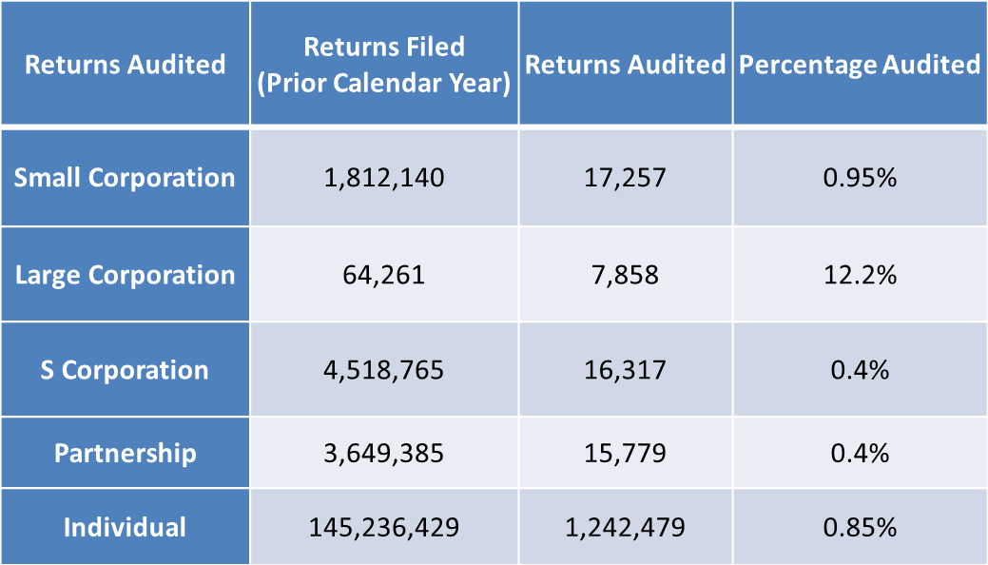
Tough times @ irs – audit stats
Overall, the odds that you are going to get picked for an audit is low each year

Slide 21
Tax related identity theft
Below are the most notable fraud tactics to be aware of:
Identity Theft:
Filing of fraudulent returns using someone else’s Social Security number. The IRS issues Identity Protection PINs (IP PINs) to victims of identity fraud; this is a unique, six-digit number that is assigned (via Notice CP01A) in order to resolve cases, and allows individuals to avoid delays in filing returns and receiving refunds.
Criminals impersonating IRS agents threatening police arrest, deportation, license revocation, and more
Offshore Tax Avoidance:
Phishing:
Fake emails or websites looking to steal personal information (NOTE- the IRS will not send you an email about a bill or refund out of the blue, so do not click on suspicious material).
Phone Scams:
Recently there has been success against offshore tax cheats and the financial organizations that assist such taxpayers. Taxpayers are best served by voluntarily coming into compliance, and the IRS offers the Offshore Voluntary Disclosure Program (OVDP) facilitates such a process

Slide 22
Tax related identity theft (CONT’D)
Fake Charities: Groups sometimes pretend to be charitable organizations to attract donations. Contributors should ensure donations are going to legitimate and currently eligible charities. IRS.gov has resources available to check the status of charitable organizations.
Return Preparer Fraud: Roughly 60 percent of taxpayers use tax professionals to prepare their returns; be conscious of suspicious and untrustworthy return preparers.
Inflated Refund Claims: Taxpayers need to be aware of persons promising inflated refunds. Taxpayers should be wary of anyone requesting them to sign a blank return, who promises a big refund before looking at their records, or who charges fees on a percentage of the refund.
Hiding Income with Fake Documents: Hiding taxable income by filing false Form 1099s or other fake documents is a scam taxpayers should avoid and guard against. The mere suggestion of falsifying documents to reduce tax bills or inflate tax refunds is a major warning sign, and taxpayers are legally responsible for what is on their returns regardless of the preparer.

Slide 23
WARNING SIGNS OF identity theft
If your SSN is compromised and you know or suspect you are a victim of tax-related identity theft, take these additional steps:
Respond immediately to an IRS notice by calling the number provided on the form
Complete IRS Form 14039, Identity Theft Affidavit
Continue to pay your taxes and file your tax return, even if you must do so by paper
If you previously contacted the IRS and did not have a resolution, contact the Identity Protection Specialized Unit at 1-800-908-4490.
NOTE: The IRS does not initiate contact with taxpayers by email or initiate by phone to request personal or financial information. This includes any type of electronic communication, such as text messages and social media channels.

Slide 24
CARBON TAX
Potential method to address climate change as a way to reduce carbon emissions.
A tax on the carbon contents of fossil fuels (coal, oil and natural gas) and biofuels.
Spur carbon-reducing investment as fossil fuel prices rise.

Slide 25
Tax Risk: a World of Change, your challenge

Slide 26
What is Tax Risk Management?
Accountability/Transparency to Stakeholders & Regulators
Expanding Global Internal Control
New and Complex Tax Law
Significant Accounting Developments (IFRS, FIN48, etc.)
Improving the Performance of Tax Department
26

Slide 27
Global Tax Climate Change
Governments in need of revenue
Complex tax compliance
Compliance strategies

Slide 28
Tax Risk in Today’s Dynamic Environment
The Framework
Audit Process
Tax Risk You and Your Client
Management Focus of Tax Risk
28

Slide 29
Growing Challenge: Widening Gap of Expectations
Critical Success Factors
Governance
People
Infrastructure
Operations
29

Slide 30
“Change Engines”
Globalization
World-wide Integration; the process of increasing the connectivity and interdependence of the world’s markets and businesses
Shifting Economies
Changing Models of Tax Administration
Legislative and Regulatory Change
BEPs
FATCA
Panama Papers
30

Slide 31
Time Allocation
Changes!
Tax Departments nearly tripled the time and effort to complete the quarterly and annual tax provision.
Tax return completion time has increased 35%.
31

Slide 32
Focus Tax Risk Management – keep us out of trouble
Risk Identification & Assessment
Process & Controls Monitoring
Teaming with Internal Audit
Process and Controls Remediation & Improvement

Slide 33
Effectively managing tax risk across the company
Operations
Tax Department Operations
Transfer Pricing
Customs
VAT/GST
Compliance
Tax Compliance
Tax Audits
Strategic
Tax Planning
Tax Management
Mergers and Acquisitions
Tax Risk Universe - Finance
Tax Financial Reporting
Tax Internal Control

Slide 34
Tax Risk
Penalties
Assessments
Additional Taxes
Harm to Reputation
Lost Opportunities
Financial Statement Exposure

Slide 35
Tax Risk - examples
Inadequate involvement of Tax Department in enterprise business planning
Failure to perform required business activities or changes in business operations in support of tax planning
Tax Department is not involved in determining transaction structure in a timely basis resulting in higher transaction taxes
Failure to include regulated assets and liabilities related to income taxes in rate revenue base appropriately or timely
Failure to properly track or identify movement of assets or people across jurisdictions resulting nexus issues
Failure to provide transparency in tax basis of fixed assets and reliable procedures to provide capital-oriented gross temporary differences
Optimized tax accounting methods not considered for new transactions –failure to alert Tax Department
Failure to establish sustainable processes to meet new and existing accounting standards
Tax Department not aware of changes to accounting and regulatory rules that impact tax reporting or disclosure
Changes in existing or new systems do not enable or support Tax Department regulatory compliance requirements
Roles and responsibilities of third party service providers are not clearly understood or documented resulting in improper/inaccurate tax filing/report
Insufficient awareness of tax laws and accounting regulations resulting in failure to comply with tax obligations in all jurisdictions where the company operates.

Slide 36
Processes
Example of Processes
√ Planning and Transactions
√ Transfer Pricing
√ Indirect Taxes
√ Tax Provision Process
√ Internal Control Documentation
√ Tax Compliance Process
√ Controversy Management

Slide 37
effective global tax controversy control
Resources
Controversy
Information

Slide 38
Tax/Auditor Interaction to Date
Tax Risk is generally not widely understood or ignored by Auditors
Tax previously operated in “black box”
Perceived lack of competence by auditors of tax professionals
Technical tax rules perceived as barrier
Client’s Tax Director generally may be hesitant to work with Outside Auditors (including Tax Professionals at Audit Firm) in helping to manage tax risk
Most Tax Department are facing staffing shortages at a time of significant increases in workloads and don’t need additional projects at this time
Lack of understanding of the type of assistance outside auditors/tax professionals can provide
Lack of understanding of auditor’s role

Slide 39
Board/Audit Committee Tax Risk Policy
Risk Management
Tax Risk Objectives
Tax Risk Management Guiding Principles
Tax Risk Tolerance
Roles and Responsibilities
Reporting and Communication
Tax Risk Plan

Slide 40

QUESTIONS?

Slide 41
IAPA USA Regional Conference
Portland, Oregon
June 24-26, 2016
Dave Springsteen, CPA, CGMA
Partner, Practice Leader
National Tax Services
WithumSmith+Brown, PC
5 Vaughn Drive
Princeton, NJ 08540
T (609) 520 1188
M (732) 598 8924
F (609) 514 5906
dspringsteen@withum.com

