Slide 1


Uncover new revenue streams
& Enhance your Advisory Services through technology
—

Slide 2
The world of finance
professionals is changing.
Is your organisation ready?

Slide 3

Attracting talent
remains priority
Lifelong learning will become the norm

Slide 4

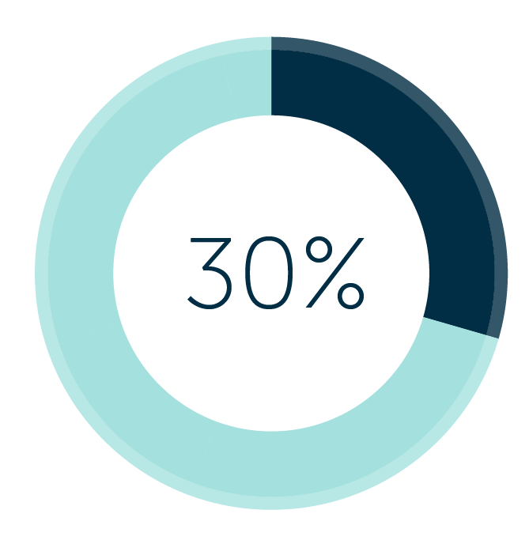
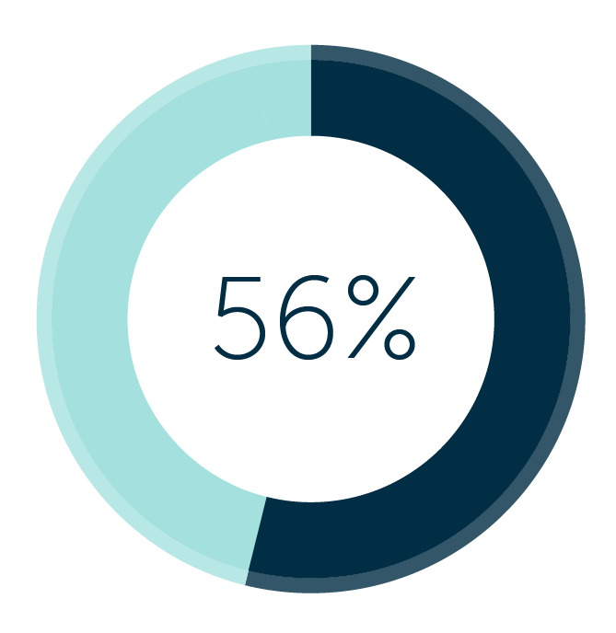
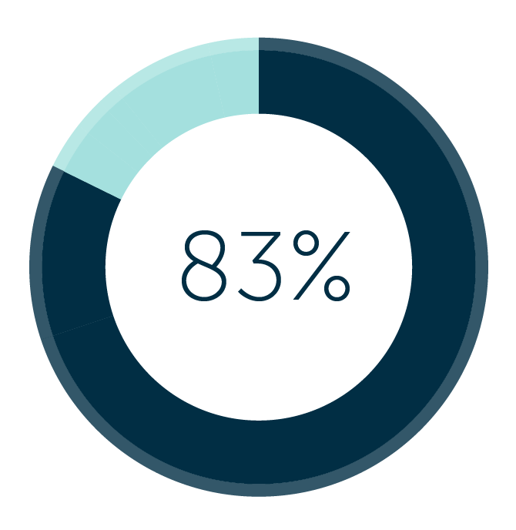
Shift in the accounting landscape
The accountant as advisor
of the entrepreneurs place accountants at the top of their list as trusted business advisors
New business models
of small businesses believe that they will use accountants for help with tasks outside of accountancy in the future
Technology as the driver
of accountants believe that understanding technology is as important to their job as understanding accountancy

Slide 5
97%
86%
PwC predicts a 97% chance of traditional accounting services being replaced by automation over the next years
However 86% of accounting firm revenue typically comes from traditional services

Slide 6
Impact of changes
Will technology replace human jobs?
Multiple data sources
Cost & change processes
Impact of Inertia?

Slide 7

“
Technology will liberate you to do work that really matters to your clients.
”

Slide 8
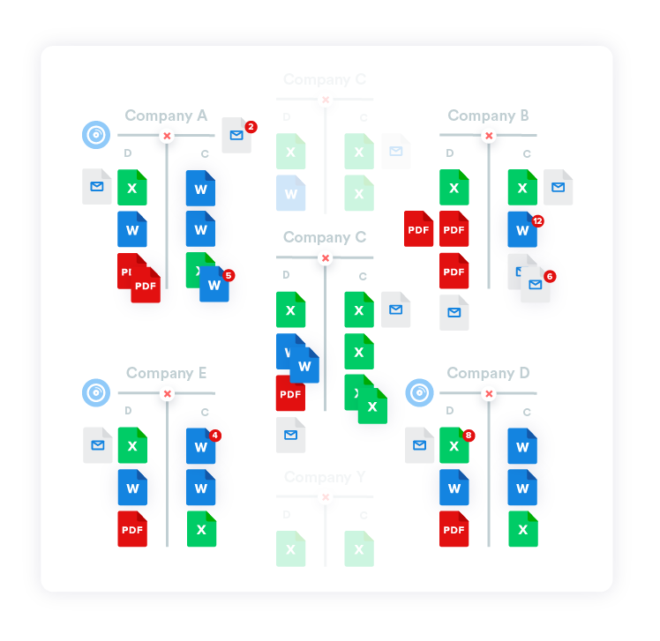
What we see on the market
— Traditional vs new way
Traditional way: Fragmented landscape
New way of working
• Multiple bookkeeping systems
• Spreadsheets for working papers & management reporting
• Accounts production software
• Annual accounts combination of documents in Word, Excel and printouts Accounting software
• Real-time, uniform datahub
• Structured financial data to next level
• Generating opportunities: Reconcile, have an audit trail, drill-down into data.

Slide 9
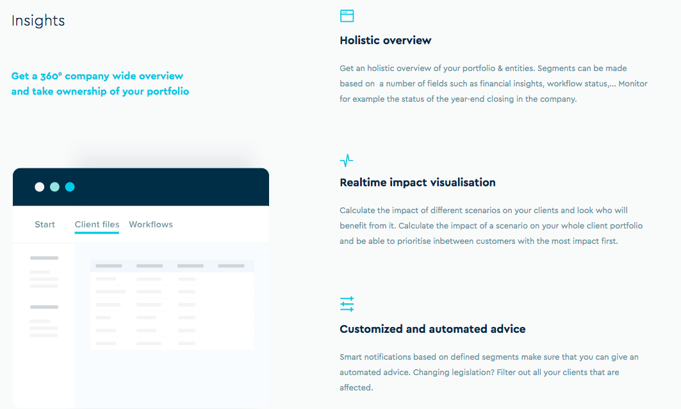
Provide a holistic view of financials to your clients
New way of working

Slide 10
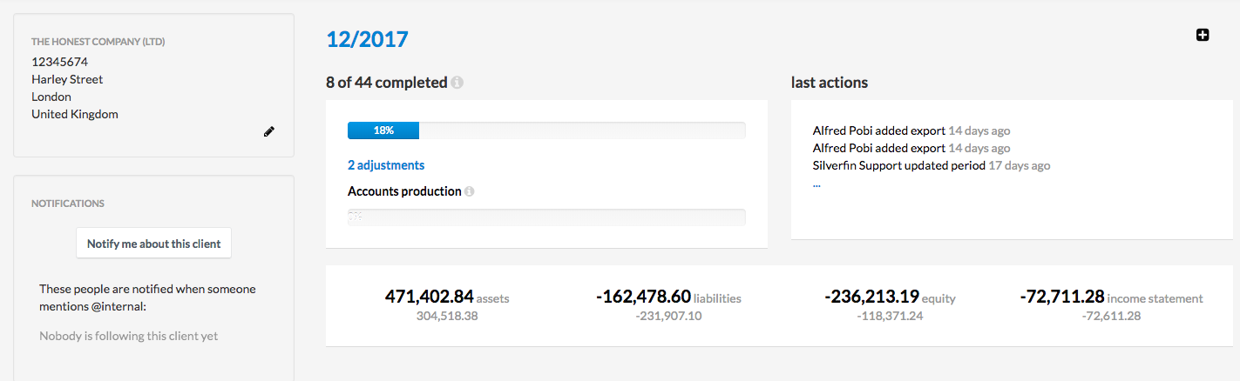
Use case 1
Imagine getting an automated overview of the status of your year-end closings

Slide 11
Use Case 2
Calculate the impact - Bespoke reporting
Following our mid-year review, the conditions for the reduced tax rate that you benefit from will change. For example, the remuneration of the manager will be €45,000 on an annual basis, whereas today it is €38,695. If we do not make these changes, this could lead to a potential tax increase of €12.435 (25% instead of 20%, based on your current annual profit of €248.700)

Slide 12
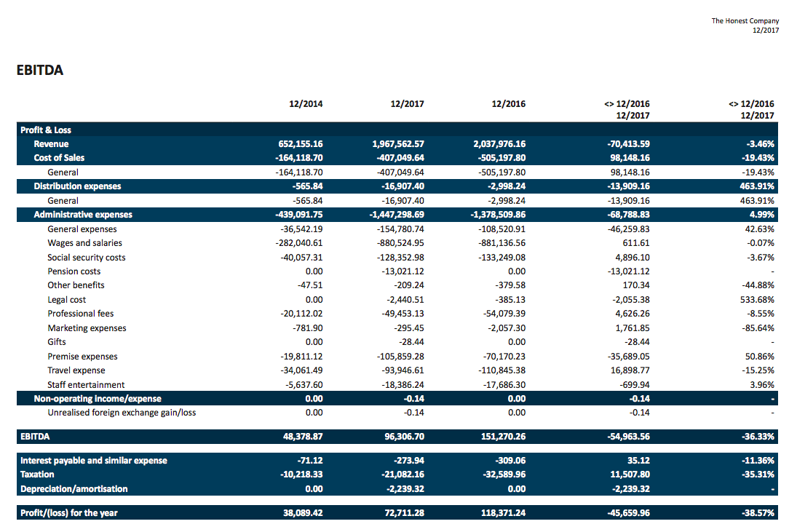
Use case 3
Send out reports to your clients with customized numbers of the impact and year on year insights

Slide 13
Finance professionals should become proactive and connected while leveraging structured financial data to create new business opportunities.

Slide 14

Thank you!
alfred@silverfin.com
+44 7487 854 645
—

