Slide 1
IAPA Audit Forum
Chaired by Juergen Liebhart
1.30pm – 3.30pm

Slide 2
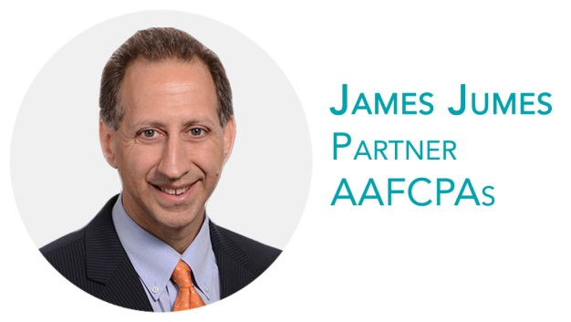
Service Organisation Controls (SOC) Reporting
+1 774.512.4062 | jjumes@aafcpa.com
www.linkedin.com/in/jamesjumes

Slide 3


Agenda
The age of the service organization
What do you do with a SOC report in relation to a financial statement audit?
SOC reporting primer
Using a SOC report in an audit
Example report excerpts
SOC assessment
Questions

Slide 4

The age of the service organisation
AAFCPAs has seen a big wave of clients making the decision to outsource various functions of administrative or business processes.
The reasons clients tell us they decide to outsource:
Looking to focus more on core mission,
Want to understand and budget costs,
Greater flexibility to respond to customers,
Access a greater available skill set,
Have a more secure and controlled environment,
Abililty to depend on experts to do the job.

Slide 5
The age of the service organisation
Some examples of outsourced services include
Managed accounting services
Bookeeping
Payroll
Billing and collections
Benefits administration
Software as a service e.g. NetSuite and many others
Medical records
Cloud services e.g. Amazon and many others
Data centers
Outsourcing appears to be working for our clients but how does an auditor get comfort over processes that impact financial transactions?
Service Organisation Controls (SOC) reports

Slide 6

SOC reporting primer
SOC Reports
Designed to enable an independent auditor to evaluate a service organisation’s controls by using the work of another auditor.
Focuses on controls at a service organization relevant to user entities’ Internal Control over Financial Reporting (except SOC 2, SOC 2+, SOC 3).
These are not “certifications” e.g. ISO 27000, PCI, OWASP.
USA- AICPA | International- IAASB | Canada- CICA | Germany- IDW
SSAE 16 (SOC 1) SOC 2 SOC 2+ SOC 3 | ISAE 3402 | CSAE 3416 | PS 951

Slide 7

SOC reporting primer
SOC Reports
Can focus on the entire service organization’s services, or just applicable data centers, operating environments, applications, or services performed for specific clients.
The use of the report is restricted to specified parties.
The report is typically used by auditors.
Reports are often issued under an anchor standard and then issued in conformity with another international standard. e.g. FuelPlus based in Germany issues under SSAE 16 in conformity with ISAE 3402.

Slide 8
SOC reporting primer
x
There are two types of SOC Reports.
Type 1 Report | Type 2 Report
the description fairly presents the system that was designed and implemented as of | the description fairly presents the system that was designed and implemented throughout the period
the controls related to the control objectives stated in the description were suitably designed to provide reasonable assurance that the control objectives would be achieved if the controls operated effectively as of | the controls related to the control objectives stated in the description were suitably designed throughout the period
None | the controls tested, were those necessary to provide reasonable assurance that the control objectives stated in the description were achieved, operated effectively throughout the period

Slide 9
What do you do with a SOC report in relation to a financial statement audit?
x
Just stick it into the binder and call it a day ☺

Slide 10
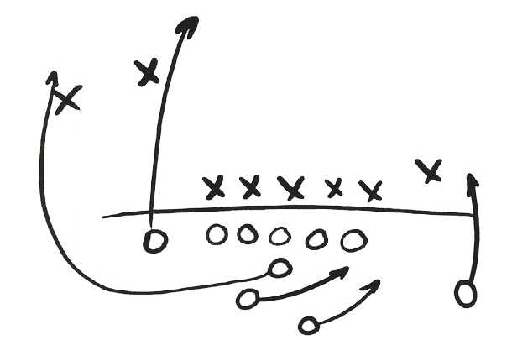
Using a SOC report in an audit
Blocking and Tackling First
What are the transaction classes?
What services are applicable to my client?
What type of SOC report is it?
Is it a type 1 or type 2 report?
Are the periods aligned?
Is there a bridge letter if not.
Is the period sufficient?
At least 6 month report.
Is the opinion qualified in any way?
What were the exceptions?

Slide 11
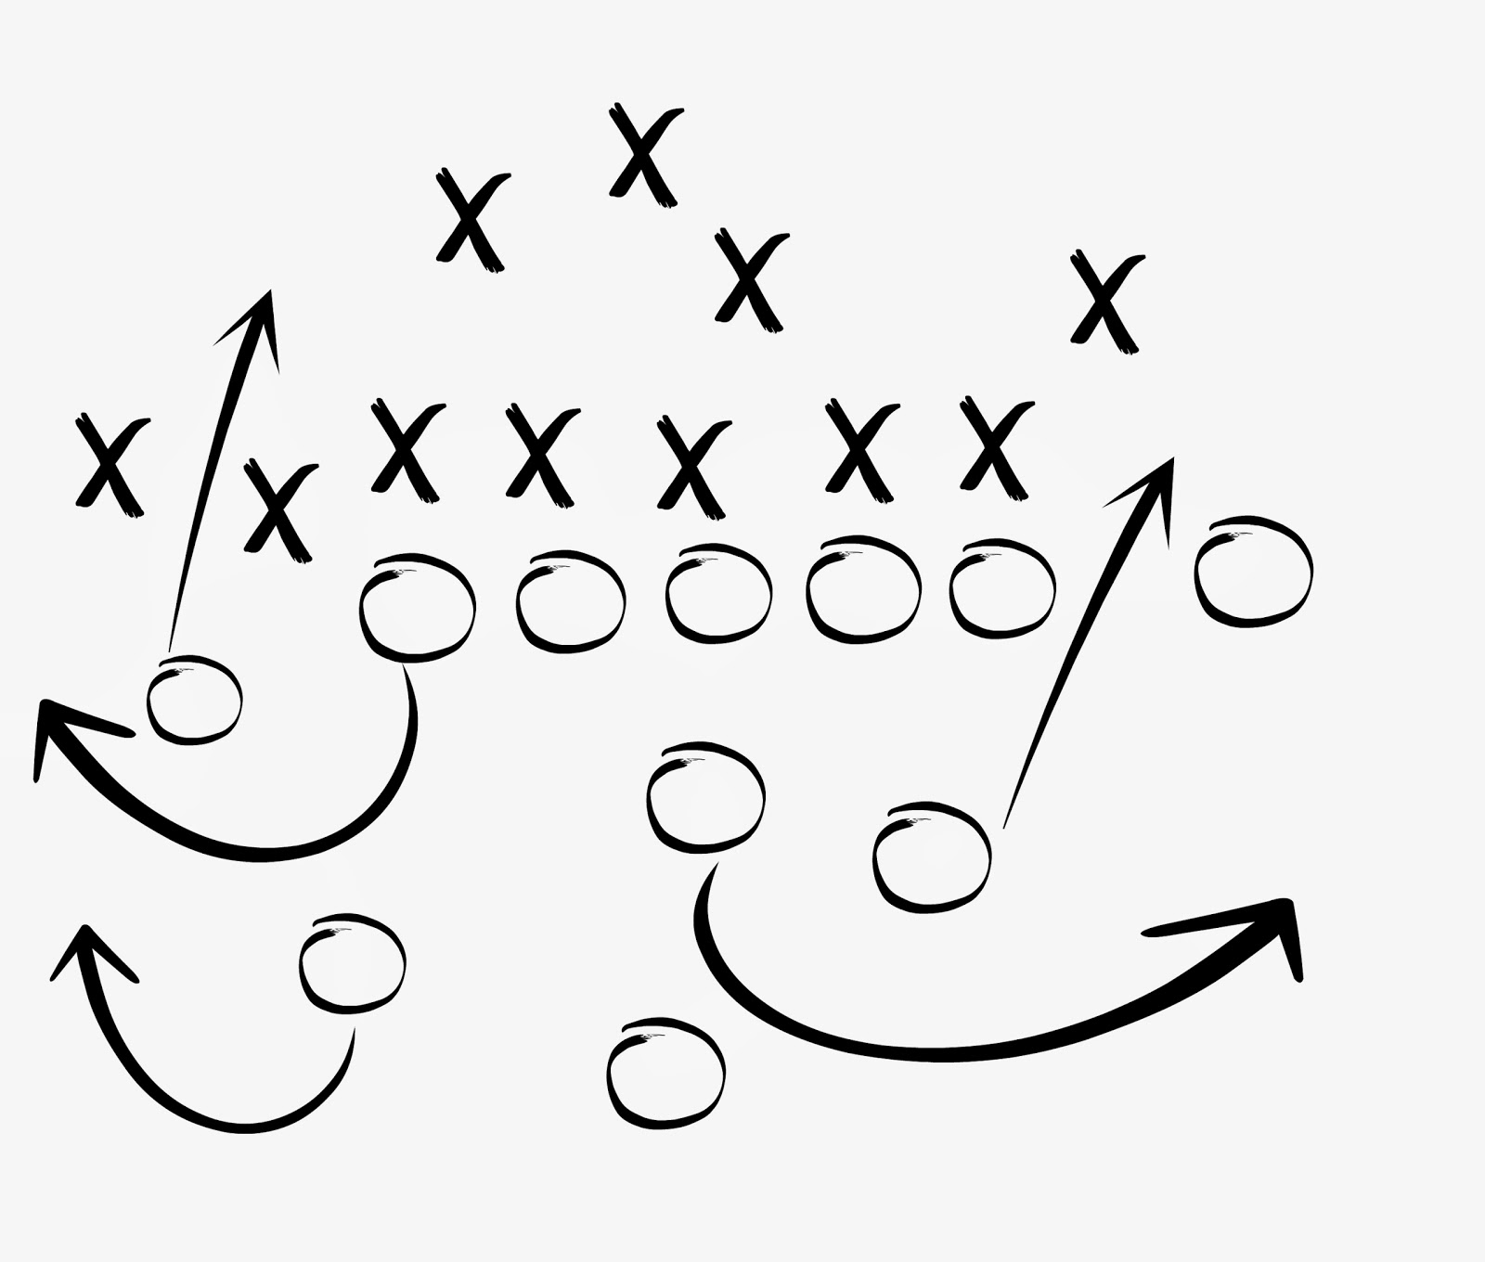
Using a SOC report in an audit
Blocking and Tackling First
Are management’s assertions reasonable and appropriate?
Did the auditor use the carve out or inclusive method?
Do I need to chase down more reports?
Do the objectives address the risks?
Do the controls fully support the objectives?
Is the testing appropriate?
Inquiry alone?
All aspects of the control?
System of control.
User Control Considerations

Slide 12

Example report excerpts

Slide 13
Example report excerpts

Slide 14
Example report excerpts

Slide 15
Example report excerpts

Slide 16

SOC Assessment

Slide 17
SOC Assessment

Slide 18
SOC Assessment
User Entity Controls | Are the User entity controls documented in the report critical for the financial assertions (audit manager decision) | If Yes, then were they tested/ walkthrough and documented? | Test or walkthrough | Control appropriately designed/ implemented
PSM
User Organizations should have policies and procedures for protecting the passwords related to user IDs used to access systems.
User Organizations should have procedures to ensure that only appropriate personnel are authorized to approve the modification of user access for their personnel.
User Organizations should have procedures to ensure that user access to applications and infrastructure systems by User Organization personnel is regularly reviewed to confirm and appropriateness of user access.
User Organizations should have procedures to ensure that timely notifications are provided to PSM of terminated or transferred User Organization employees with access to systems.
User Organizations should have procedures to ensure that only authorized employees have the ability to access data.
User Organizations should ensure that its network configuration supports the limitation of access

Slide 19
Questions & Comments
774.512.4062 jjumes@aafcpa.com

Slide 20
Thank You!
For more information, visit: www.aafcpa.com

