Slide 1
Global Indirect Tax News & Trends
Lisa Dowling,
Senior VAT Manager
September 11th, 2018
TaxbackInternational.com

Slide 2
Talking points:
1
Digital Tax Measures
2
Worldwide spread of VAT/GST
SAF-T, Control lists, MTD, Electronic Invoicing, Real Time Reporting
India, GCC and Malaysia
3
Changes and trends with VAT rates
4
Indirect tax news and rule changes
Movement of rates and comments
Online sellers, US sales tax, VAT Action Plan

Slide 3
Digital Tax Measures
Great ideas, great technological advances, no standardisation across jurisdictions

Slide 4
No Standardisation = differences across jurisdictions
What data is collected
How it is reported
When it is reported
Thresholds

Slide 5
What recent digitization and advanced reporting requirements have been introduced?
SAF-T
Control lists
Making Tax Digital
- UK
Electronic
Invoicing
Real time
reporting
Death of the VAT return?

Slide 6
SAF - T
Standard Audit File for Tax

Slide 7
SAF-T – Standard Audit File for Tax
Developed by the Organisation for Economic Co-operation and Development (“OECD”).
Electronic format which enables the transfer of data from organisations to tax authorities in a standardised, electronic format.
Enable tax authorities to conduct more efficient and effective inspections.
Austria, France, Luxembourg, Portugal, Lithuania, Norway and Poland have introduced SAF-T requirements.
No international standard list of data elements for SAF-T.

Slide 8
SAF-T – Poland update
Poland plans to replace VAT returns with new SAF-T in 2019.
Currently file VAT returns and SAF-T monthly
A new version of the SAF-T, JPK_VDEK is set to replace the requirement to file a VAT return and SAF-T separately.
The idea of eliminating the obligation to file VAT returns was announced during the Deputy Minister of Finance’s speech in the Parliament in December 2017. However, since that speech it is still not known when the VAT returns filling obligation will be dropped

Slide 9
Control Lists
Domestic VAT listing – advanced reporting

Slide 10
Control lists – advanced reporting
Domestic VAT listings have two main goals:
Fighting VAT fraud by giving a tax administration a tool that allows easier and faster detection of fraudsters and fraudulent chains.
Increasing voluntary compliance by introducing a form of a third party reporting where each trader identifies its clients and/or suppliers as well as the amount of the transactions.
Currently there are at least 12 Member States in the European Union that collect data on domestic transactions.
VAT listing is a domestic measure so again there are no international standards on data collected and the format.

Slide 11
Common themes with advanced reporting
Again, no standardisation
The fight against VAT fraud
Increased compliance burden for global organisations
Improved risk analysis for tax offices
Improved auditing techniques
Increased compliance
Collection of data and enforcing compliance in various forms

Slide 12
UK – MTD for VAT
Making Tax Digital for VAT

Slide 13
UK – Making Tax Digital for VAT
Introduced to make HMRC -
“one of the most digitally advanced tax administrations in the world”
First step – Making tax digital for VAT - April 2019.
This is not real time reporting.
This is the same VAT return process through digitised reporting.
From April 2019, organisations will need to submit VAT returns in a digital format via and Application Programming Interface (“API”).

Slide 14
UK – Making Tax Digital for VAT
Transitioning from manual to digital records will be challenging.
Spreadsheet users will need bridging software or API-enabled spreadsheet to digitally submit the VAT return data to HMRC.
HMRC will publish a list of ‘approved’ software when the public testing opens.
In the meantime, HMRC has published a list of software developers who have gone through successful testing.
Soft landing until 31 March 2020 – for VAT return periods commencing between 1 April 2019 and 31 March 2020, HMRC will not enforce the requirement to have digital links between software programs that contribute to the VAT return workings.
During the soft landing period, the use of ‘cut/copy and paste or manual transposition is acceptable.

Slide 15
Further digitisation
The future?

Slide 16
Further digitisation
China & India
Immediate reconciliation of your suppliers sales to populate your inputs and to avail of input VAT credit
Electronic Invoicing in Italy (& Portugal – just announced B2G) *
The initial conditions for Italian electronic invoicing were as follows:
With effect from 1 January 2019, invoices and related corrections for supplies of goods and services between parties resident, established or VAT registered in Italy must be issued electronically, as provided by Law No. 205 of 27 December 2017 (the Budget Law for 2018).
On the 2nd July 2018 the Italian Tax Authorities (“ITA”) issued a Circular No. 13/E to provide some clarification:
* The electronic invoicing obligation is not mandatory where the supplier is a non-resident taxable person registered in Italy for VAT purposes through direct VAT identification or appointment of a VAT representative

Slide 17
Real Time Reporting
Spain and Hungary

Slide 18
Real Time Reporting - Spain
Immediate Supply of Information (“SII”).
Large tax taxpayers filing monthly returns.
Real time reporting of sales and purchase data.
Originally 8 days from the date of the sales invoice or from the date on which the purchase invoice was “booked” to the company’s accounts.
Now 4 days

Slide 19
Real Time Reporting - Spain
Reporting of purchases includes the reporting of employee expenses and non-deductible items.
The automatic transfer of data through SII kicks back an exception report if any data is not in the required format e.g. supplier VAT registration number missing a prefix

Slide 20
Real Time Reporting - Hungary
Introduced from 1st July 2018
Only applicable to sales transactions
Any Hungarian VAT registered entity that issues invoices with a VAT amount above HUF 100,000 (approx. EUR 320) to another entity VAT registered in Hungary.

Slide 21
Real Time Reporting - Hungary
Reporting of those sales transactions “without delay” to the HU TO meaning….
Invoices must be reported immediately as they are issued, without human intervention.
Includes businesses established outside Hungary but VAT registered in Hungary.
Only sales
Only domestic transaction
Only B2B
Only invoices with VAT of more than HUF 100,000

Slide 22
Worldwide Spread of VAT/GST
India, GCC and Malaysia

Slide 23
India – GST introduced 1st July 2017
The GST journey began in the year 2000 when a committee was set up to draft law.
It took 17 years from then for the Law to evolve.
On 1st July 2017 the GST Law came into force.
GST was introduced mainly to remove the cascading effect on the sale of goods and services.
In the pre-GST regime, every purchaser including the final consumer paid tax on tax. This tax on tax is called Cascading Effect of Taxes.
Since tax on tax is eliminated in this regime, the cost of goods decreases.

Slide 24
India – GST introduced 1st July 2017
GST in India is mainly technologically driven. All activities like registration, return filing, application for refund and response to notice needs to be done online on the GST Portal.
There are 3 taxes applicable under this system: CGST, SGST & IGST.
CGST
SGST
IGST
Collected by the Central Government on an intra-state sale
Collected by the State Government on an intra-state sale
Collected by the Central Government for inter-state sale

Slide 25
India – GST introduced 1st July 2017
The following is the list of indirect taxes in the pre-GST regime:
Central Excise Duty
Duties of Excise
Additional Duties of Excise
Additional Duties of Customs
Special Additional Duty of Customs
Cess
State VAT
Central Sales Tax
Purchase Tax
Luxury Tax
Entertainment Tax
Entry Tax
Taxes on advertisements
Taxes on lotteries, betting, and gambling
CGST, SGST, and IGST has replaced all the above taxes.

Slide 26
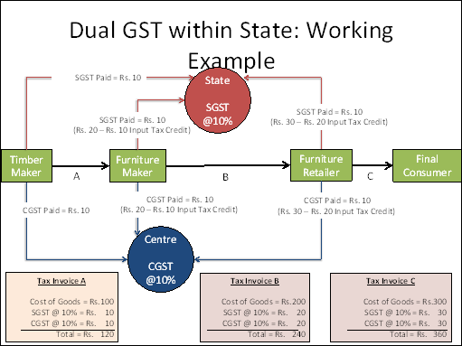
India – GST introduced 1st July 2017

Slide 27
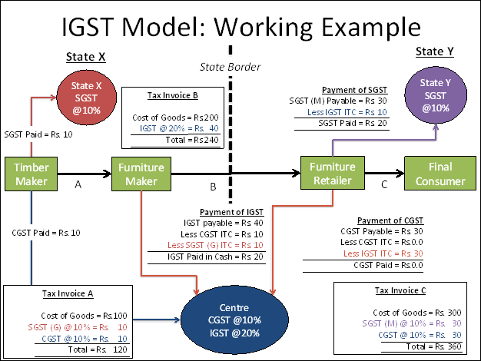
India – GST introduced 1st July 2017

Slide 28
India – GST introduced 1st July 2017
What are the major features of the returns filing procedures under GST?
Common return would serve the purpose of both Central and State Government.
There are eight forms provided for in the GST business processes for filing for returns.
Most of the average tax payers would be using only four forms for filing their returns.
These are returns for supplies, returns for purchases, monthly returns and an annual return.
Filing of returns shall be completed online. All taxes can also be paid online.

Slide 29
India – GST introduced 1st July 2017
The GST Council has approved a new simplified return filing process under which all taxpayers will have to file a maximum of one month tax return.
Sales and purchases reported in one return.
Avail on input credit based on the invoices uploaded by suppliers.
VAT return table will be auto populated with basic sales and purchase information based on invoices uploaded.
The new VAT return form is expected to be modular in format and will be completed based on the profile of the trader.
Upload – Lock - Pay
Applicable from 2019

Slide 30
GCC – VAT introduced from 1st January 2018
In 2016, the six member states of the Gulf Cooperation Council (GCC) signed an agreement binding each to introduce a national Value Added Tax @ 5%
Saudi Arabia and the United Arab Emirates began implementing VAT on January 1, 2018.
When will the other four GCC members—Bahrain, Kuwait, Oman and Qatar— follow suit?
“Technically they should be able to be ready in a year and a half,” (mid-Q3 2019) Abdelhak Senhadji, Deputy Director of The Fiscal Affairs Department at the IMF

Slide 31
GCC – VAT introduced from 1st January 2018
VAT in UAE and KSA very similar to the EU VAT system.
Consistency between states?
Differing lists of exemptions and zero rated supplies.
E.g. Education – UAE, typically zero rated, KSA, typically exempt from VAT for public school and VATable at the standard rate for private schools.
Different VAT return filing periods and deadlines.
UAE, typically quarterly and KSA typically monthly.

Slide 32
Malaysia – GST scrapped from 1st June 2018
GST was introduced in 2015 and has since been blamed for the rising cost of living in Malaysia.
Sales and Services Tax (SST) was reintroduced on 1 September 2018.
With the proposition that the SST will decrease living expenses to the general population, economists have raised concerns about how the government will find new sources to match the GST revenue collection.
SST is only charged on taxable goods manufactured by a taxable person or a business that has an annual turnover exceeding 500,000 ringgit ($169,000).
Among the items that will not be taxed are rice, cooking oil, bread and baby products.

Slide 33
VAT/GST rates
Changes and trends

Slide 34
VAT rate movements
Country | Change | Effective date | Trend
Austria | 13% to 10% on accommodation services | 1 Nov 2018
Croatia | 25% to 24% standard rate | 1 Jan 2019
Iceland | 24% to 22.5% standard rate | 1 Jan 2019
Romania | 19% to 18% standard rate | 1 Jan 2019
Netherlands | 6% to 9% reduced rate | 1 Jan 2019
Russia | 18% to 20% standard rate | 1 Jan 2019

Slide 35
Other news and rule changes
Online sellers & the digital economy
VAT Action Plan

Slide 36
Australia – GST on low value goods
As of 1 July 2018, Australian GST will apply to sales of low value goods (goods with a customs value of AUD1,000 or less when the price is first agreed with the customer and except for tobacco products and alcoholic beverages) imported by consumers into Australia.
Businesses with sales (subject to Australian GST) of AUD75,000 or more to consumers in Australia within a 12 month period, will need to register with the Australian Tax Office, collect GST at the point of sale and remit that GST to the ATO.
Similar rules will apply in New Zealand from October 2019.

Slide 37
Russia – VAT rule change on cross-border, e-commerce
From Jan 17, non-resident providers of e-services to Russian consumers have had to register and charge Russian VAT.
From Jan 19, this rule will be extended to non-resident providers of B2B services to Russian businesses, removing the application of the reverse charge mechanism to such transactions.
Foreign businesses are required to register by 15th February 2019, via the Federal Tax Service’s portal for online service providers.
VAT returns and payments will be due on a quarterly basis by the 25th day of the month following the reporting period.

Slide 38
US sales tax – online sellers - Wayfair
The basic rule for collecting sales tax from online sales is:
If your business has a physical presence, or “nexus”, in a state, you must collect applicable sales taxes from online customers in that state.
If you do not have a physical presence, you generally do not have to collect sales tax for online sales.
However, in June of 2018, the U.S. Supreme Court issued a ruling that will likely change this exemption to collecting sales tax. States are expected to begin collecting sales taxes regardless of having a physical presence in the state.
South Dakota V Wayfair

Slide 39
US sales tax – online sellers –
Wayfair
States can now choose to tax most internet sales. Only a matter of time before all states apply this tax.
Online retailers will have to track sales levels and tax law changes in all states where they do business.
Retailers will have to set up systems to collect the sales tax for all states.
Online retailers will have to increase prices to consumers.
Bricks and mortar businesses will benefit

Slide 40
VAT Action Plan
“The biggest reform of EU VAT rules in a quarter of a century”
To tackle cross-border VAT fraud the EU Commission proposes a change that will see VAT charged on cross-border trade between businesses.
As part of the EU Commission’s proposal, businesses will be able to avail of a “one-stop-shop” to account for and pay the related VAT.
The Commission has proposed a further simplification in the form of a “Certified Taxable Person”.
Due to enter into application in 2022.

Slide 41
The future for EU distance sellers
A simplification to the distance sales rules by the EU Commission in October 2017 will see an extension to the “mini one stop shop”, which currently applies to e-services
The current domestic thresholds in each Member State will be abolished and will be replaced by a single annual threshold of EUR 10,000 per year.
Changes effective from 1 Jan 2021

Slide 42
Overall trends
Digitised reporting
Immediate reporting of sales
Pre-population of inputs
Anti-fraud measures and risk analysis

Slide 43
Thank you
www.taxbackinternational.com
IDA Business & Technology Park,
Ring Road, Kilkenny,
Ireland
T +123 123 123 123 F +123 123 123 123
E info@taxbackinternational.com
Taxback International

